Slide 1
Chapter 5 – Greedy Algorithms
Parth Nagarkar
* Content borrowed from: S. Dasgupta, C. H. Papadimitriou, and U. V. Vazirani. Algorithms

Slide 2
Greedy Algorithms
Instead of thinking ahead, like in a game of chess, greedy algorithms focus on choosing the best at the moment
This myopic behavior is easy and convenient
Greedy algorithms build up a solution piece by piece, always choosing the next piece that offers the most obvious and immediate benefit

Slide 3
Greedy Algorithms
While the strategy of greedy algorithms can be disastrous for some computational tasks, there are many tasks where greedy algorithms are optimal

Slide 4


Example 1
Unlimited supply of coins
Give me $50 in smallest
number of coins as possible
$5 coins
$10 coins
$20 coins
Notes:
How would you do it? 2 X 20 + 1 X 10
Dollar bag from: https://creazilla.com/nodes/24626-money-bag-american-dollar-clipart

Slide 5
Example 1
Unlimited supply of coins
Give me $15 in smallest
number of coins as possible
$5 coins
$10 coins
$20 coins
Notes:
How would you do it? 1 X 10 + 1 X 5
Dollar bag from: https://creazilla.com/nodes/24626-money-bag-american-dollar-clipart

Slide 6
Example 1
Unlimited supply of coins
Give me $65 in smallest
number of coins as possible
$5 coins
$10 coins
$20 coins
Notes:
How would you do it? 3 X 20 + 1 X 5
Dollar bag from: https://creazilla.com/nodes/24626-money-bag-american-dollar-clipart

Slide 7
Example 1
Unlimited supply of coins
Give me $65 in smallest
number of coins as possible
$5 coins
$10 coins
$20 coins
In each iteration, you have to choose a coin of the largest value that does not take the total beyond the amount that was asked
Notes:
How would you do it? 3 X 20 + 1 X 5
Dollar bag from: https://creazilla.com/nodes/24626-money-bag-american-dollar-clipart

Slide 8
Example 1
Unlimited supply of coins
Give me $65 in smallest
number of coins as possible
$5 coins
$10 coins
$20 coins
Aka you choose greedily for the next best solution
and see if it satisfies your overall solution
Notes:
How would you do it? 3 X 20 + 1 X 5
Dollar bag from: https://creazilla.com/nodes/24626-money-bag-american-dollar-clipart

Slide 9
Example 2
10
A
B
10
10
S
T
20
X
Y
20
20
Find the shortest path from the source node to the target node

Slide 10
Example 2
10
A
B
10
10
S
T
20
X
Y
2
2
Find the shortest path from the source node to the target node

Slide 11
Greedy Algorithms
10
A
B
10
10
S
T
20
X
Y
2
2
Greedy algorithms help you find the local optimum, but not necessarily the global optimum

Slide 12
Greedy Algorithms
A greedy algorithm can be used to solve the problem if it satisfies these 2 properties:
Greedy choice property:
A global (overall) optimal solution can be reached by choosing the optimal choice at each step
Optimal substructure:
A problem has an optimal substructure if an optimal solution to the entire problem contains the optimal solutions to the sub-problems
Notes:
Greedy Algorithms. Brilliant.org. Retrieved October 2020, from https://brilliant.org/wiki/greedy-algorithm/

Slide 13
Greedy Algorithms
Dijkstra’s algorithm for finding shortest paths
Kruskal’s algorithm and Prim’s algorithm for finding minimum spanning trees
Huffman Encoding
Set Cover

Slide 14
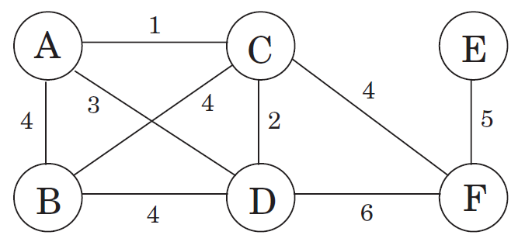
Minimum Spanning Trees
Consider a telecommunications company wants to lay cable in this neighborhood
Nodes are the houses, the edges are the paths between them, and the edge weights are the maintenance cost
The goal is to find the cheapest way to lay cable while connecting all houses

Slide 15
Minimum Spanning Trees
A spanning tree is a subgraph that is a tree which includes all the vertices of G with a minimum possible number of edges
A minimum spanning tree would be the one with the lowest total cost, representing the least expensive path for laying the cable

Slide 16
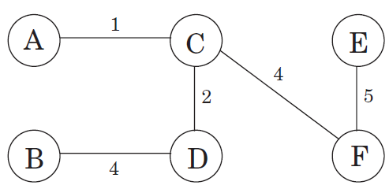
Minimum Spanning Trees
In this example, the minimum spanning tree has a cost of 16
There can be multiple optimal solutions to a problem (if they exist)

Slide 17
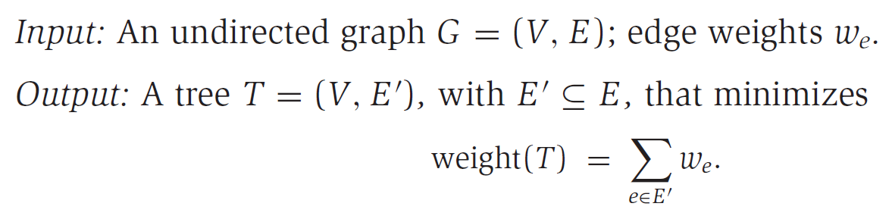
Minimum Spanning Trees

Slide 18
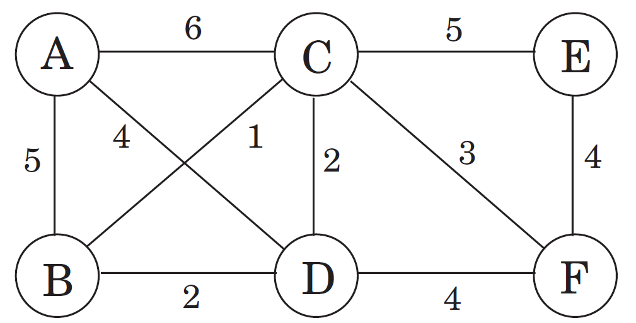
Greedy Approach (Kruskal’s) to find MSTs
Repeatedly add the next best edge that does not produce a cycle
Ties are broken arbitrarily
It is greedy because every decision it makes is the one with the most obvious immediate advantage

Slide 19
Greedy Approach (Kruskal’s) to find MSTs
B – C
C – D
B – D
Not added because it produces a cycle
C – F
D – F
E – F
A – D
A – B
C – E
A – C

Slide 20
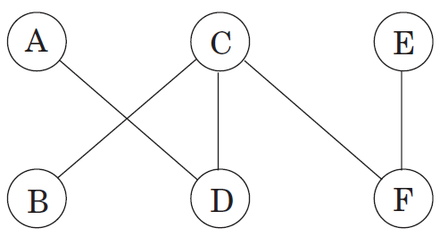
Greedy Approach (Kruskal’s) to find MSTs
The final result is a tree with the minimum possible cost of 14

Slide 21
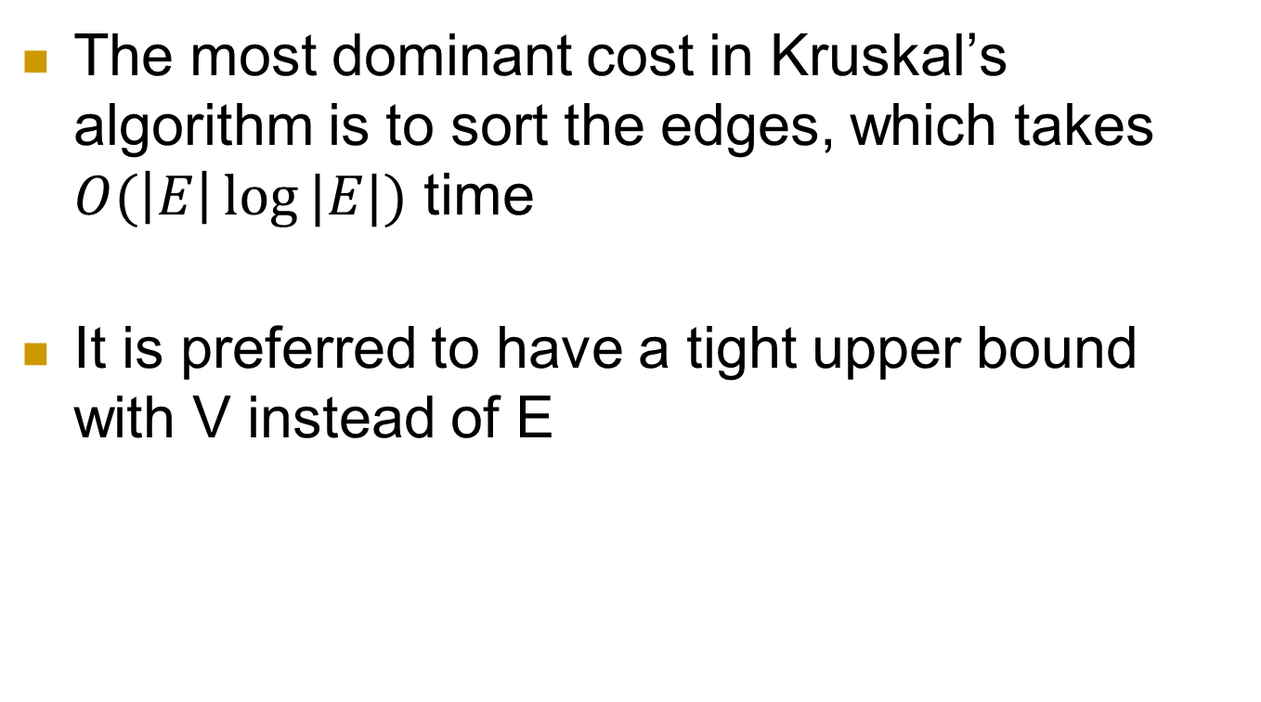
Complexity of Kruskal’s Algorithm
The most dominant cost in Kruskal’s algorithm is to sort the edges, which takes $O(\left|E\right|\log{|E|)}$ time
It is preferred to have a tight upper bound with V instead of E

Slide 22
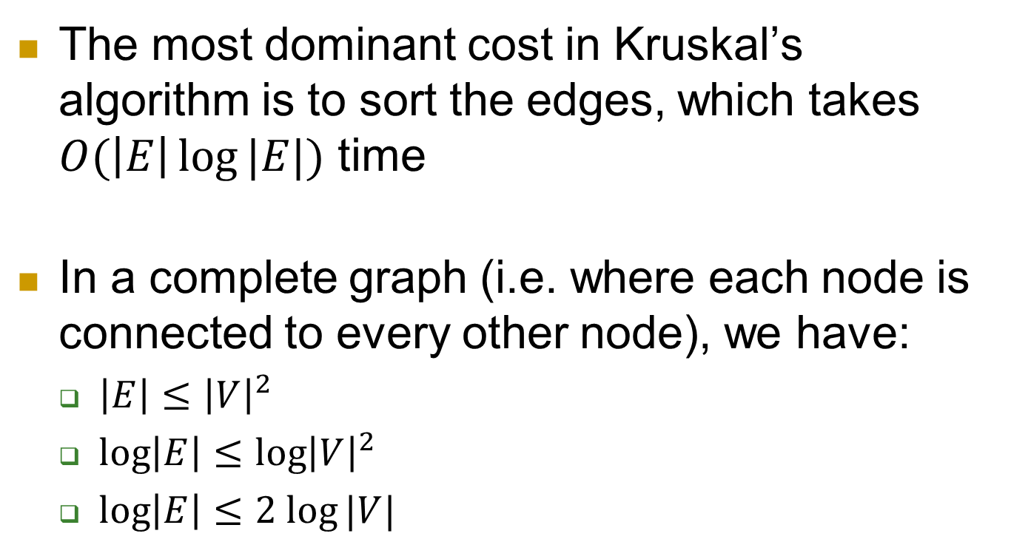
Complexity of Kruskal’s Algorithm
The most dominant cost in Kruskal’s algorithm is to sort the edges, which takes $O(\left|E\right|\log{|E|)}$ time
In a complete graph (i.e. where each node is connected to every other node), we have:
$\left|E\right|≤{\left|V\right|}^{2}$
$\log\left|E\right|≤\log{{\left|V\right|}^{2}}$
$\log\left|E\right|≤2 log⁡|V|$

Slide 23
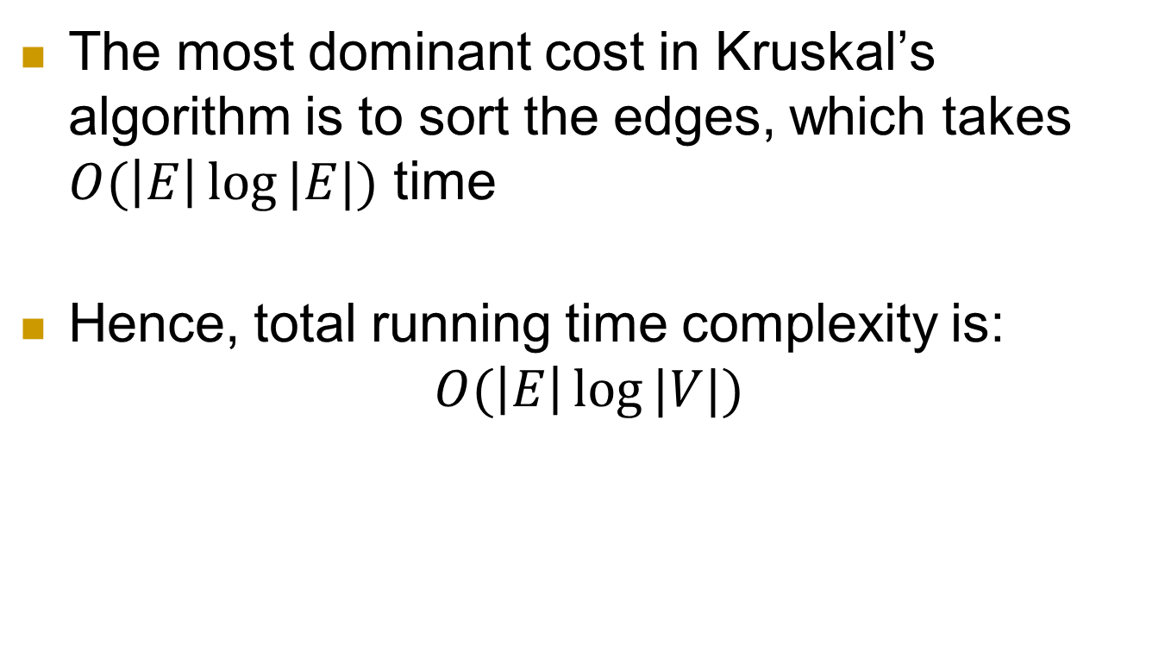
Complexity of Kruskal’s Algorithm
The most dominant cost in Kruskal’s algorithm is to sort the edges, which takes $O(\left|E\right|\log{|E|)}$ time
Hence, total running time complexity is: $O(\left|E\right|\log{|V|)}$

Slide 24
Greedy Approach (Prim’s) to find MSTs
Choose any vertex randomly
Select the best edge from the set of edges connected to one of the seen vertices
Cannot produce a cycle
Repeat this process until you have seen all vertices

Slide 25
Greedy Approach (Prim’s) to find MSTs
We start with A
A – D
C – D
B – C
C – F
E – F

Slide 26
Greedy Approach (Prim’s) to find MSTs
The final result is a tree with the minimum possible cost of 14

Slide 27
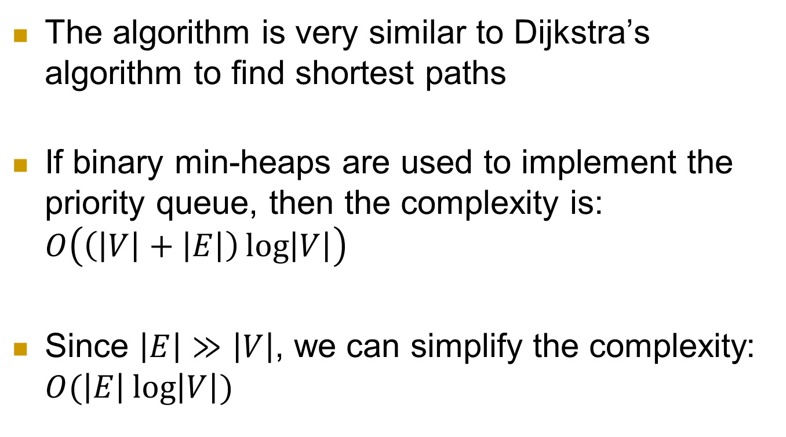
Complexity of Prim’s Algorithm
The algorithm is very similar to Dijkstra’s algorithm to find shortest paths
If binary min-heaps are used to implement the priority queue, then the complexity is: $O\left(\left(\left|V\right|+\left|E\right|\right)\log\left|V\right|\right)$
Since $\left|E\right|≫\left|V\right|$, we can simplify the complexity: $O(\left|E\right|\log\left|V\right|)$

Slide 28
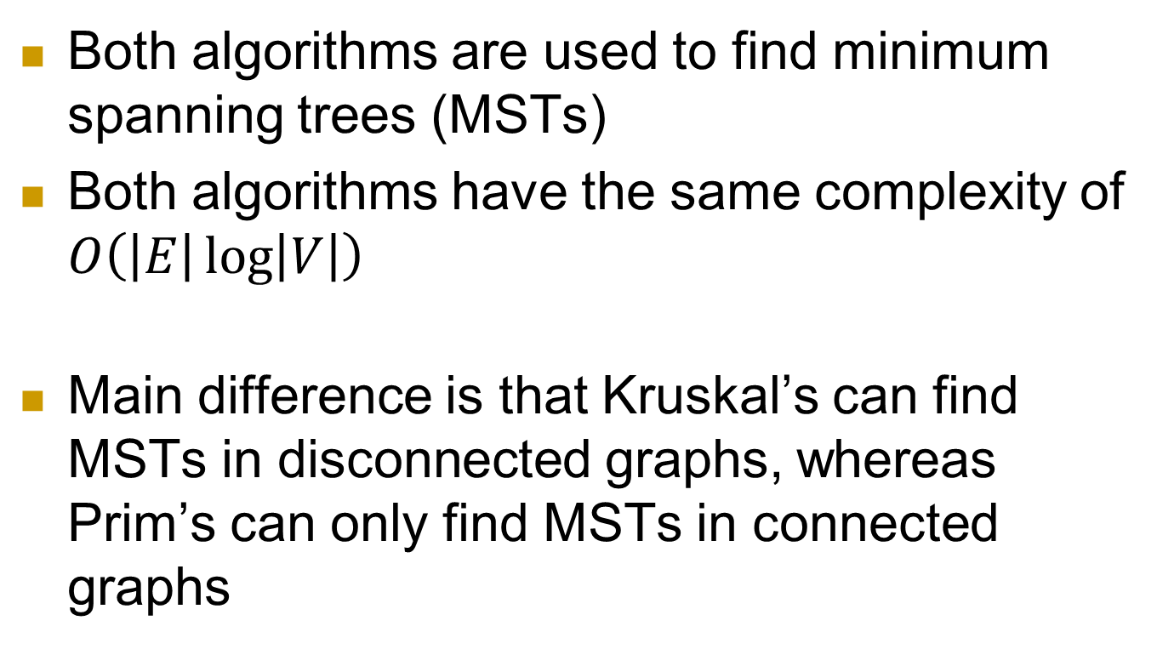
Kruskal’s vs Prim’s Algorithms
Both algorithms are used to find minimum spanning trees (MSTs)
Both algorithms have the same complexity of $O\left(\left|E\right|\log\left|V\right|\right)$
Main difference is that Kruskal’s can find MSTs in disconnected graphs, whereas Prim’s can only find MSTs in connected graphs

Slide 29
Job Scheduling Problem
Given a set of tasks with deadlines and total profit earned on completion of a task, find maximum profit earned by executing the tasks within the specific deadlines.
Assume any task will take one unit of time to execute
Any task cannot be executed after its deadline
Only one task can be executed at a given moment in time
What is the complexity of your solution? Justify your answer
Notes:
https://www.techiedelight.com/job-sequencing-problem-deadlines/

Slide 30



Job Scheduling Problem
If the following schedule is executed:
1→2→3→4→
Then, 5 cannot be scheduled since it cannot be started before its deadline
Notes:
https://www.techiedelight.com/job-sequencing-problem-deadlines/

Slide 31
Platform Scheduling Problem
Given a schedule containing arrival and departure time of trains in a station, find minimum number of platforms needed in the station to avoid any delay in arrival of any train
What is the complexity of your solution? Justify your answer
Notes:
https://www.techiedelight.com/minimum-number-of-platforms-needed-avoid-delay-arrival-train/

Slide 32
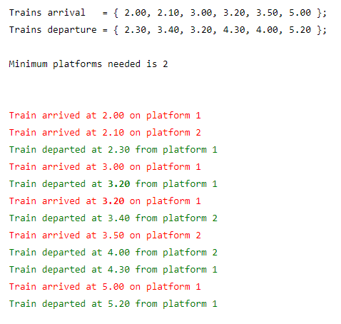
Platform Scheduling Problem
Notes:
https://www.techiedelight.com/minimum-number-of-platforms-needed-avoid-delay-arrival-train/

